Slide 1
SEGUIN I.S.D.
Financial Integrity Rating System of Texas (FIRST REPORT)
2019-2020 Ratings based on school year 2018-19 data.
Scoring system is based on a series of indicators (questions)
    A – Superior Achievement Score 90 - 100
    B – Above Standard Achievement Score 80 - 89
    C – Standard Achievement Score 60 - 79
    F – Substandard Achievement Score below 60

Slide 2
SEGUIN I.S.D.
Financial Integrity Rating System of Texas (FIRST REPORT)
THE INDICATORS

Slide 3
SEGUIN I.S.D.
Financial Integrity Rating System of Texas (FIRST REPORT)
INDICATOR 1:
  Was the annual financial report filed within 30 days after the TEA set deadline of November 27th?
RESPONSE:
  Report was received by TEA on 11/06/19
SCORE:
  Passed

Slide 4
SEGUIN I.S.D.
Financial Integrity Rating System of Texas (FIRST REPORT)
INDICATOR 2.A:
  Was there an unmodified opinion in the annual financial report on the financial statements as a whole?
RESPONSE:
  For 2018-19, Seguin ISD received an unmodified, or clean, opinion.
SCORE:
  Passed

Slide 5
SEGUIN I.S.D.
Financial Integrity Rating System of Texas (FIRST REPORT)
INDICATOR 2.B:
  Did the external auditor report that the financial statements were free of any instances of material weaknesses in internal controls?
RESPONSE:
  The external auditor reported no material weaknesses in the audit report for Seguin ISD.
SCORE:
  Passed

Slide 6
SEGUIN I.S.D.
Financial Integrity Rating System of Texas (FIRST REPORT)
INDICATOR 3:
  Was the district in compliance with the payment terms of all debt agreements at fiscal year end?
RESPONSE:
  Debt payments were made within the requirements of bond covenants.
SCORE:
  Passed

Slide 7
SEGUIN I.S.D.
Financial Integrity Rating System of Texas (FIRST REPORT)
INDICATOR 4:
  Did the district make timely payments to Teachers Retirement System, Texas Workforce Commission, Internal Revenue Service, and other government agencies?
RESPONSE:
  All reports and payments were submitted timely to governmental entities.
SCORE:
  Passed

Slide 8
SEGUIN I.S.D.
Financial Integrity Rating System of Texas (FIRST REPORT)
INDICATOR 5:
  This indicator is not being scored.
RESPONSE:
  n/a
SCORE:
  n/a

Slide 9
SEGUIN I.S.D.
Financial Integrity Rating System of Texas (FIRST REPORT)
INDICATOR 6:
  Was the number of days of cash on hand and current investments in the general fund for the school district sufficient to cover operating expenditures?
RESPONSE:
  Seguin ISD had sufficient cash and investments in the General Fund.
SCORE: (maximum possible score: 10 points)
  10 Points

Slide 10
SEGUIN I.S.D.
Financial Integrity Rating System of Texas (FIRST REPORT)
INDICATOR 7:
  Was the measure of current assets to current liabilities ratio for the school district sufficient to cover short-term debt?
RESPONSE:
          Current Assets $55,742,582
          Current Liabilities $16,960,775
          Ratio: 3.2866
  Current assets were sufficient to cover current liabilities.
SCORE: (maximum possible score: 10 points)
  10 Points

Slide 11
SEGUIN I.S.D.
Financial Integrity Rating System of Texas (FIRST REPORT)
INDICATOR 8:
  Was the ratio of long-term liabilities to total assets for the school district sufficient to support long-term solvency?
RESPONSE:
          Long Term Liabilities $141,888,392
          Total Assets $195,526,002
          Ratio: 0.7257
  Assets were sufficient to cover liabilities.
SCORE: (maximum possible score: 10 points)
  6 Points (points reduction due to Net Pension Liability new reporting requirement)

Slide 12
SEGUIN I.S.D.
Financial Integrity Rating System of Texas (FIRST REPORT)
INDICATOR 9:
  Did the school district’s general fund revenues equal or exceed expenditures?
RESPONSE:
          Total Revenue $62,534,381
      Total Expenditures $60,581,648
          Net Result of Operations $ 1,952,733
          Revenues were sufficient to cover expenditures.
SCORE: (maximum possible score: 10 points)
  10 Points

Slide 13
SEGUIN I.S.D.
Financial Integrity Rating System of Texas (FIRST REPORT)
INDICATOR 10:
  Was the debt service coverage ratio sufficient to meet the required debt service?
RESPONSE:
  Resources were sufficient to meet required debt service.
SCORE: (maximum possible score: 10 points)
  10 Points

Slide 14
SEGUIN I.S.D.
Financial Integrity Rating System of Texas (FIRST REPORT)
INDICATOR 11:
  Was the district’s administrative cost ratio less than the threshold ratio?
RESPONSE:
    Acceptable Administrative Cost Ratio 10.000%
    Seguin ISD Administrative Cost Ratio 9.97%
  Seguin ISD’s administrative cost ratio was less than the threshold.
SCORE: (maximum possible score: 10 points)
  10 Points

Slide 15
SEGUIN I.S.D.
Financial Integrity Rating System of Texas (FIRST REPORT)
INDICATOR 12:
  Did the school district not have a 15% decline in the students to staff ratio over 3 years?
RESPONSE:
  Seguin ISD did not have a decline in its ratio of students to staff that was outside the acceptable range.
SCORE: (maximum possible score: 10 points)
  10 Points

Slide 16
SEGUIN I.S.D.
Financial Integrity Rating System of Texas (FIRST REPORT)
INDICATOR 13:
  Did the comparison of PEIMS data to like information in the annual financial report result in a variance of less than 3% of expenditures per function?
RESPONSE:
          Sum of Differences $147
          Expenditures $61,408,860
  The PEIMS financial data submitted by Seguin ISD to TEA had an insignificant variance in comparison to the data published in the annual financial report. The variance is due to system rounding.
SCORE: (maximum possible score: 10 points)
  10 Points

Slide 17
SEGUIN I.S.D.
Financial Integrity Rating System of Texas (FIRST REPORT)
INDICATOR 14:
  Did the external auditor indicate the financial statements were free of any instance(s) of material noncompliance for grants, contracts, and laws related to local, state, or federal funds?
RESPONSE:
  The Seguin ISD annual financial report indicated no material noncompliance.
SCORE: (maximum possible score: 10 points)
  10 Points

Slide 18
SEGUIN I.S.D.
Financial Integrity Rating System of Texas (FIRST REPORT)
INDICATOR 15:
  Did the school district not receive an adjusted repayment schedule for more than one fiscal year for an overall allocation of Foundation School Program funds as a result of a financial hardship?
RESPONSE:
  Seguin ISD had no adjusted repayment schedule.
SCORE: (maximum possible score: 10 points)
  10 Points

Slide 19
SEGUIN I.S.D.
Financial Integrity Rating System of Texas (FIRST REPORT)
  Seguin ISD FIRST Results for 2019
  A – Superior Achievement
  96 Points (maximum possible score: 100 points)

Slide 20
SEGUIN I.S.D.
Financial Integrity Rating System of Texas (FIRST REPORT)
PRIOR YEAR COMPARISON

Slide 21
SEGUIN I.S.D.
Financial Integrity Rating System of Texas (FIRST REPORT)
INDICATOR 1 2.A 2.B 3 4 5 6 7 8 9 10 11 12 13 14 15
2019
PASS
PASS
PASS
PASS
PASS
n/a
10
10
6
10
10
10
10
10
10
10
2018
PASS
PASS
PASS
PASS
PASS
n/a
10
10
6
10
10
10
10
10
10
10
2017 PASS PASS PASS PASS PASS PASS 10 10 6 10 10 10 10 10 10 10
2016 PASS PASS PASS PASS PASS PASS 6 10 8 10 10 10 10 10 10 10
TOTAL SCORE
96
96
96
94

Slide 22
SEGUIN I.S.D.
Financial Integrity Rating System of Texas (FIRST REPORT)
REQUIRED DISCLOSURE:
Reimbursements Received by the Superintendent and Board Members for Fiscal Year 2019

Slide 23
SEGUIN I.S.D.
Financial Integrity Rating System of Texas (FIRST REPORT)
Reimbursements Received by the Superintendent and Board Members for Fiscal Year 2019
For the Twelve-Month Period
Ended June 30, 2019
 | Superintendent | Board Members
Description | Dr. Matthew Gutierrez | Benito Amador | Denise Crettenden | Ishmael Flores |  | Alejandro Guerra | John Holt |  | Linda Duncan | Carl Jenkins | Elaina Reihl | Glenda Moreno | Cinde Thomas-Jimenez
Meals | 1,142.25 | - | - | - |  | 39.00 | 93.00 |  | - | - | - | - | -
Lodging | 4,438.92 | - | - | - |  | 552.63 | 762.84 |  | - | - | - | - | -
Transportation | 2,623.37 | - | - | - |  | 221.40 | 201.10 |  | - | - | - | 141.24 | 85.62
Registration | 4,694.95 | 199.75 | 249.75 | 50.00 |  | 624.75 | 425.00 |  | 249.75 | 249.75 | 50.00 | 249.75 | 199.75
Other | 29.90 | - | - | - |  | - | - |  | - | - | - | - | -
Total | $ 12,959.39 | $ 199.75 | $ 249.75 | $ 50.00 |  | $ 1,437.78 | $ 1,481.94 |  | $ 249.75 | $ 249.75 | $ 50.00 | $ 390.99 | $ 285.37

Slide 24
SEGUIN I.S.D.
Financial Integrity Rating System of Texas (FIRST REPORT)
Outside Compensation and/or Fees Received by the Superintendent for Professional Consulting and/or Other Personal Services in Fiscal Year 2018
For the Twelve-Month Period
Ended June 30, 2019 |  |  | $0.00
Note-Compensation does not include business revenues from the superintendent's livestock or agricultural livestock or agricultural based activities on a ranch or farm. Revenues generated from a family business that have no relationship to school district business are not disclosed.
Gifts Received by Executive Officers and Board Members (and First Degree Relatives, if any) in Fiscal Year 2018
For the Twelve-Month Period
Ended June 30, 2019 |  |  | None
Note – An executive officer is defined as the superintendent, unless the board of trustees or the district administration names additional staff under this classification. (Any gifts received by their immediate family as described in Government Code, Chapter 573, Subchapter B, Relationships by Consanguinity or by Affinity are reported under the applicable school official.)
Business Transactions Between School District and Board Members for Fiscal Year 2018
For the Twelve-Month Period
Ended June 30, 2019 |  |  | None
Note - The summary amounts reported under this disclosure do not duplicate the items disclosed in the summary schedule of reimbursements received by board members.
Other Information. None

Slide 25
SEGUIN I.S.D.
Financial Integrity Rating System of Texas (FIRST REPORT)
REQUIRED DISCLOSURE:
Local Government Officer Conflicts Disclosure Statement

Slide 26
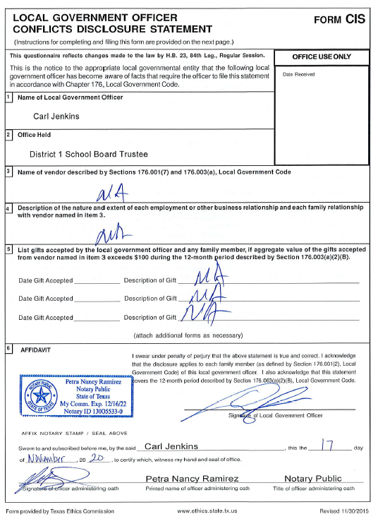
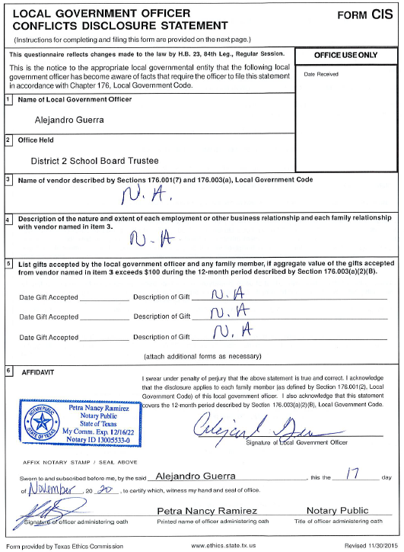

Slide 27
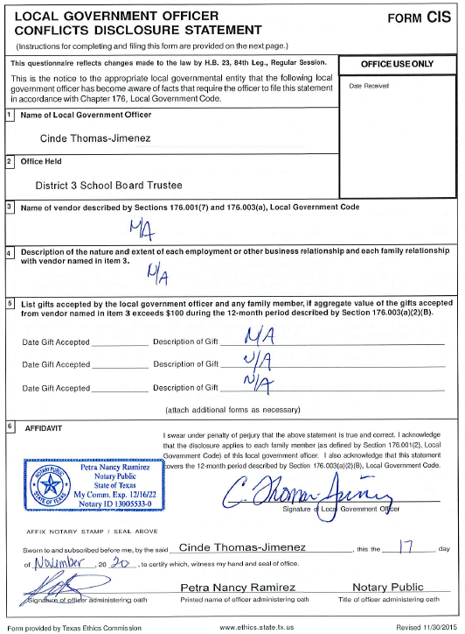
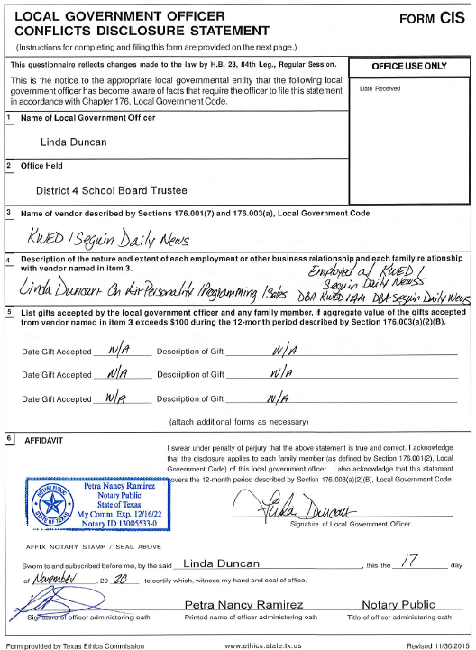

Slide 28
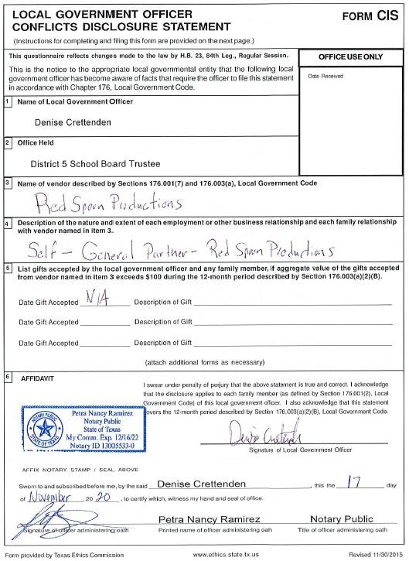
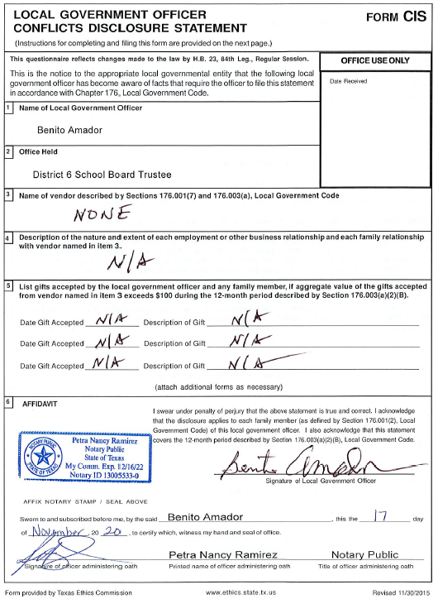

Slide 29
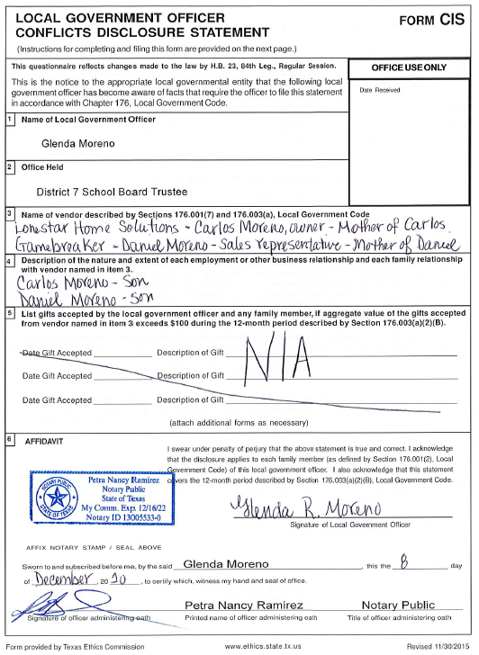

Slide 30
SEGUIN I.S.D.
Financial Integrity Rating System of Texas (FIRST REPORT)
REQUIRED DISCLOSURE:
Official 2019-2020 FIRST Report from TEA

Slide 31
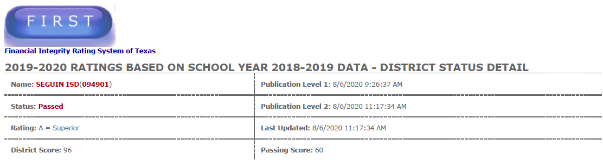

Slide 32
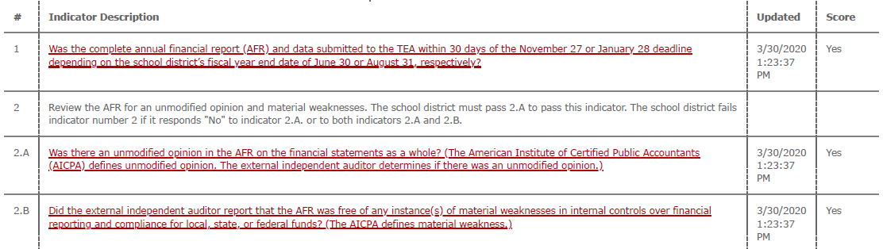

Slide 33
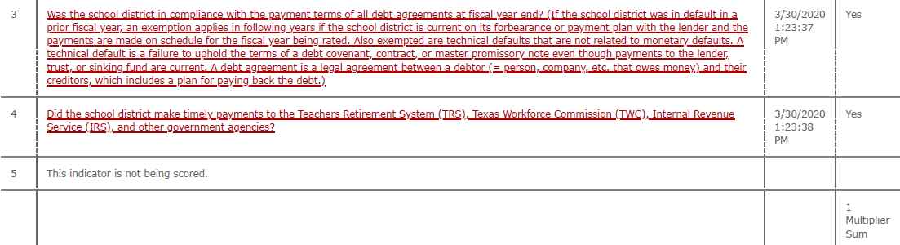

Slide 34
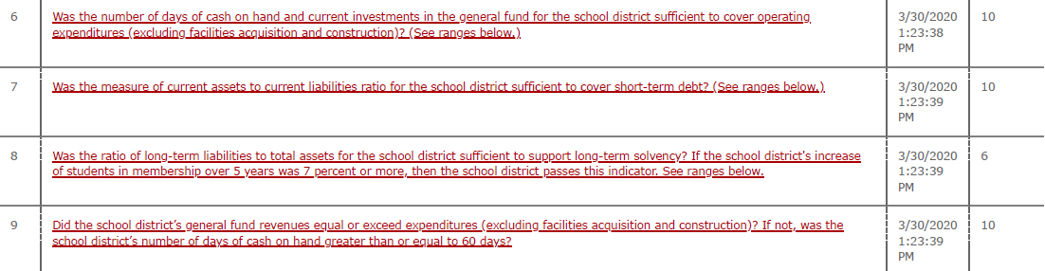

Slide 35
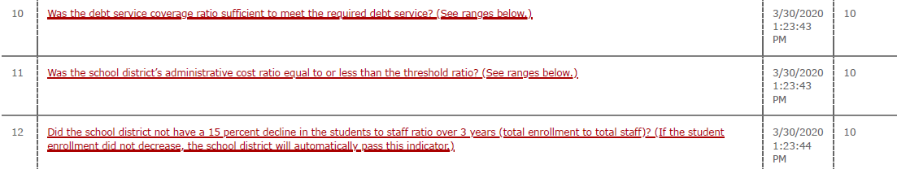

Slide 36
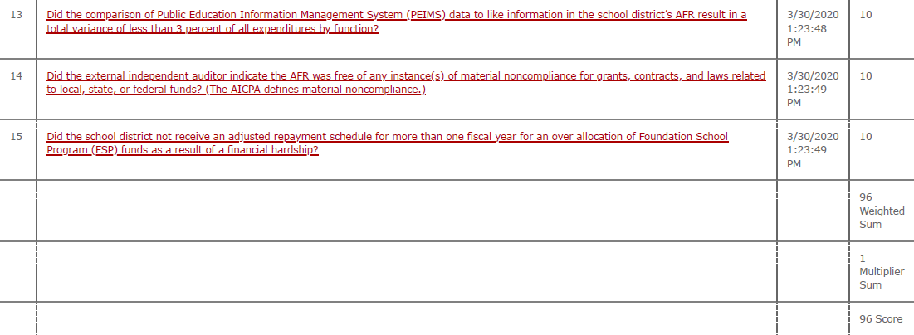

Slide 37
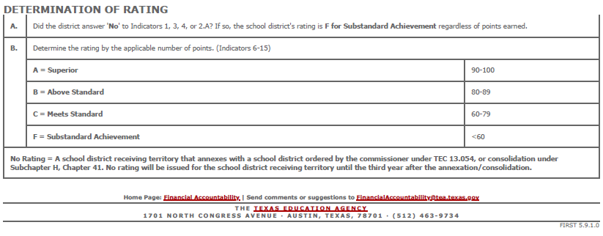
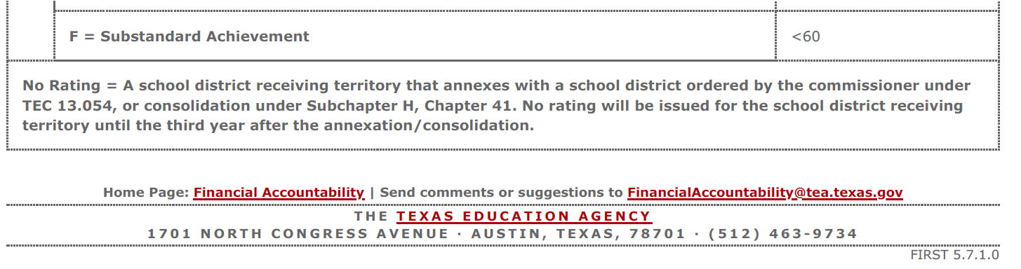

Slide 38
SEGUIN I.S.D.
Financial Integrity Rating System of Texas (FIRST REPORT)
REQUIRED DISCLOSURE:
Superintendent’s Employment Contract
https://www.seguin.k12.tx.us/upload/page/0141/2020-2021%20FTP/CG_11-17-20%20Supt%20Contract.pdf

Slide 39
SEGUIN I.S.D.
Financial Integrity Rating System of Texas (FIRST REPORT)
QUESTIONS
(Contact Tony Hillberg, Chief Financial Officer)
(830) 401-8605
thillberg@seguin.k12.tx.us

